Slide 1
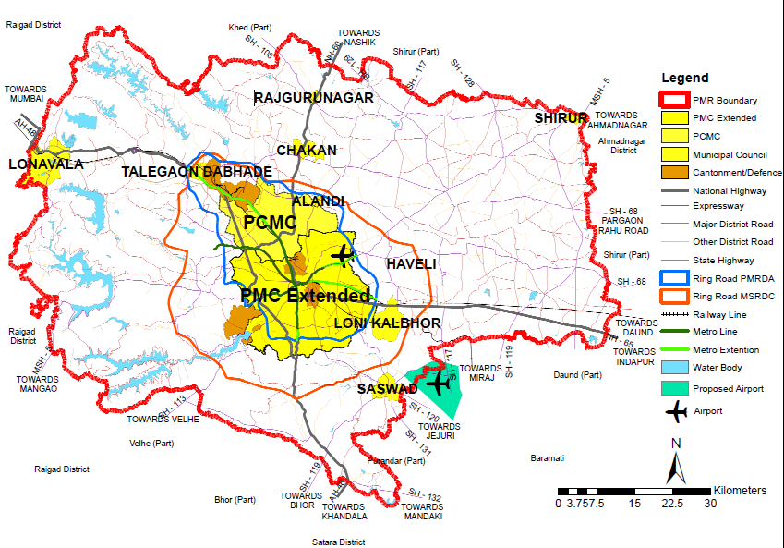
Title: Regional transport network map in Pune Metropolitan Region
Map description and analysis
Introduction:
The Pune metropolitan region (PMR) is a sub part of Pune district which consist of 9 taluka out of which 3 talukas are completely included and 6 are partial.
Road hierarchy:
The PMR includes a express way, 3 national highway, 1 major state highway 19 State highways.
PMR consist of 5,202.3 km of total road length of Pune district i.e. 19,274.3 km, which 27% of Pune District roads
Road density:
Maval and Mulshi talukas have low road density per area due to restriction of western ghat region and less villages
Bhor and Daund talukas have maximum road density
Rail connectivity:
PMR is connected by the railway from the east and west direction with 3 existing rail routes i.e. Pune–Mumbai, Pune–Solapur, Pune–Miraj.
The railway length passing through PMR is 159.5 km out 503.39 km of Pune division i.e.31.7 of total Pune Division rail length passes through the PMR.
There are total 30 station in PMR, all of them are broad gauge and double track.
Air connectivity:
PMR has one international airport located at Lohegaon and one proposed airport at Purandar
It is 10 km away from Pune city and has connectivity through the SH-27 and a 18 meter wide road.
Team Name: RuDRA
Topic: Transport Network Map
Team member/lead:
Organization: Rural Data Research and Analysis Lab
Data courtesy: BHUVAN, Pune Metropolitan Region Development Authority (PMRDA), Pune Municipal Corporation (PMC), Pimpri-Chinchwad Municipal Corporation (PCMC), Maharashtra State Road Development Corporation (MSRDC)
Contact/email: www.data-lab.in

